Slide 1

Department of Computer Engineering & Applications
GLA University
Mathura- 281406, INDIA
2020-21

Slide 2
Mini Project Presentation on
WeTube
By :
Aditya Kumar Das (181500041)
Gaurav Kumar (181500233)
Prashant Verma (181500493)
Pulkit Ranjan (181500519)
Vishes Keshari (181500813)

Slide 3
Introduction
In current scenario, Major advancements in technology have drastically changed how and where we share information, showcase our talent, conduct business, Advertise, entertain people or Educate the world with more people working remotely, the rise of instant, on-demand and cheap platform for communications and the globalization of information was inevitable. With many students using smart phones, video is a great platform to reach them.
WeTube is a video streaming web application solution to build a website similar to YouTube. It is designed to boost simplicity to both service providers and users.
WeTube web application has features such as Login through Google account, browse and search desired videos, add videos to watch later section, allow user to post their comments on them and provide option to share videos, etc.

Slide 4
Problem Statement and Objective
The project is to create a video streaming web application service where users can watch, share, comment on videos posted by other users and get the data about videos, channel and subscription.
To create a responsiveness video streaming media web application with UI similar to YouTube.
Users can watch, share and post comment on videos.
User can save videos to watch later.
Users can watch videos posted by other users and upload videos of their own.
Login through google account.
User can filter the recommendation using Categories Bar
User can monitor the data about videos like number of likes, views and dislikes.
Also, data about channel like its description, subscriptions, videos and main icon.
This application also recommends user related videos and show up-next videos.
Give user ability to search videos and channels
Application must support Pagination

Slide 5
WeTube project has following features:
Login through google account.
Homepage UI
Categories Bar
Data about videos (number of likes, views and dislikes)
Data about channel (icon, description, subscriptions, videos)
Ability to post comments
Ability to share videos
Feature to save videos to watch later.
Related Videos and Up-next videos
Ability to search videos and channels
Responsiveness and Pagination

Slide 6
Hardware Requirements:
Processor i3 (7th Gen) or AMD A6-7310 APU processor
2 GB RAM
1GHz or more
64-bit Operating System
minimum 25 GB Hard Disk Space
Internet Connection
Software Requirements:
Technology Implemented: React, Redux, Firebase and YouTube API, Node.js
Language Used: HTML, CSS, JavaScript
Web Browser: Google Chrome (Version: 84.0.4147.135 or above)
Code editor: Windows Visual Studio (Version: 16.0 or above)

Slide 7
Technical Knowledge required

Slide 8
HTML
HTML stands for Hyper Text Mark-up Language
HTML is the standard mark-up language for creating Web pages
HTML describes the structure of a Web page
HTML consists of a series of elements
HTML elements tell the browser how to display the content
HTML elements label pieces of content such as "this is a heading", "this is a paragraph", "this is a link", etc.

Slide 9
2. CSS
CSS stands for Cascading Style Sheets
CSS describes how HTML elements are to be displayed on screen, paper, or in other media
CSS saves a lot of work. It can control the layout of multiple web pages all at once
External stylesheets are stored in CSS files

Slide 10
3. JavaScript
JavaScript is a very powerful client-side scripting language. JavaScript is used mainly for enhancing the interaction of a user with the webpage. In other words, you can make your webpage more lively and interactive, with the help of JavaScript. JavaScript is also being used widely in game development and mobile application development.

Slide 11
4. Node.js
This is in contrast to today's more common concurrency model, in which OS threads are employed. Thread-based networking is relatively inefficient and very difficult to use. Furthermore, users of Node.js are free from worries of dead-locking the process, since there are no locks. Almost no function in Node.js directly performs I/O, so the process never blocks. Because nothing blocks, scalable systems are very reasonable to develop in Node.js.

Slide 12
5. Redux
Redux is a predictable state container for JavaScript apps. To rephrase that, it’s an application data-flow architecture, rather than a traditional library or a framework like Underscore.js and AngularJS.
Redux was created by Dan Abramov around June 2015. It was inspired by Facebook’s Flux and functional programming language Elm. Redux got popular very quickly because of its simplicity, small size (only 2 KB) and great documentation.
Redux is used mostly for application state management. To summarize it, Redux maintains the state of an entire application in a single immutable state tree (object), which can’t be changed directly. When something changes, a new object is created (using actions and reducers).

Slide 13
6. Firebase
Firebase is a platform developed by Google for creating mobile and web applications. It was originally an independent company founded in 2011. In 2014, Google acquired the platform and it is now their flagship offering for app development
7. YouTube Data API
The YouTube Application Programming Interface (YouTube API) allows developers to access video statistics and YouTube channels data via two types of calls, REST and XML-RPC. Google describe the YouTube API Resources as "APIs and Tools that let you bring the YouTube experience to your webpage, application or device.
With the YouTube Data API, you can add a variety of YouTube features to your application. Use the API to upload videos, manage playlists and subscriptions, update channel settings, and more.

Slide 14
8. React
React (also known as React.js or ReactJS) is an open-source, front end, JavaScript library for building user interfaces or UI components. It is maintained by Facebook and a community of individual developers and companies. React can be used as a base in the development of single-page or mobile applications. However, React is only concerned with state management and rendering that state to the DOM, so creating React applications usually requires the use of additional libraries for routing, as well as certain client-side functionality.

Slide 15
9. npm
npm , Inc. is a company founded in 2014, and was acquired by GitHub in 2020. npm is a critical part of the JavaScript community and helps support one of the largest developer ecosystems in the world.
npm is lots of things.
npm is the package manager for Node.js. It was created in 2009 as an open source project to help JavaScript developers easily share packaged modules of code.
The npm Registry is a public collection of packages of open-source code for Node.js, front-end web apps, mobile apps, robots, routers, and countless other needs of the JavaScript community.
npm is the command line client that allows developers to install and publish those packages.

Slide 16
Implementation Details
First, made design for our website using pencil wireframe.
Next, we initialized our NodeJS Project.
Then downloaded important packages like React-Bootstrap, Bootstrap (main), Node-SASS (version 4.14.1), React-icons.
Then we have created our React Application.
We then created and designed our Home Screen UI.
Then we did React Router Set Up
Then Redux setup.
Then Firebase authentication.
Then we made Private Route.
After these we created our Categories Bar
Then we added Most Popular videos feature
We then made this WeTube application support Pagination (infinite scroll)

Slide 17
Implementation Details
Then we built loading skeleton and add lazy load images
Then we did setup of our watch screen, video player and give ability to see details of video and channel.
Then we added the feature to post comment on videos.
After these we created additional features like related videos and up-next videos.
Then we did setup Search screen.
And then finally Subscription Screen and in that ability to stream videos of any particular channel.

Slide 18
Implementation
(Here are some Screenshots of the project)

Slide 19
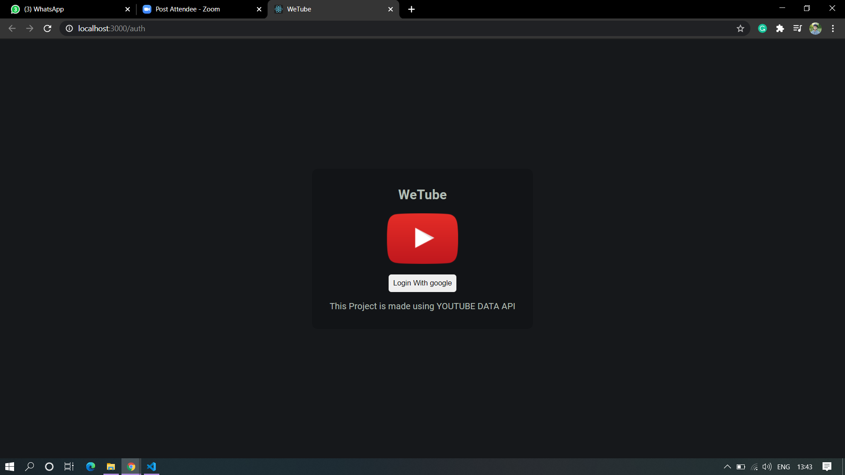

Slide 20
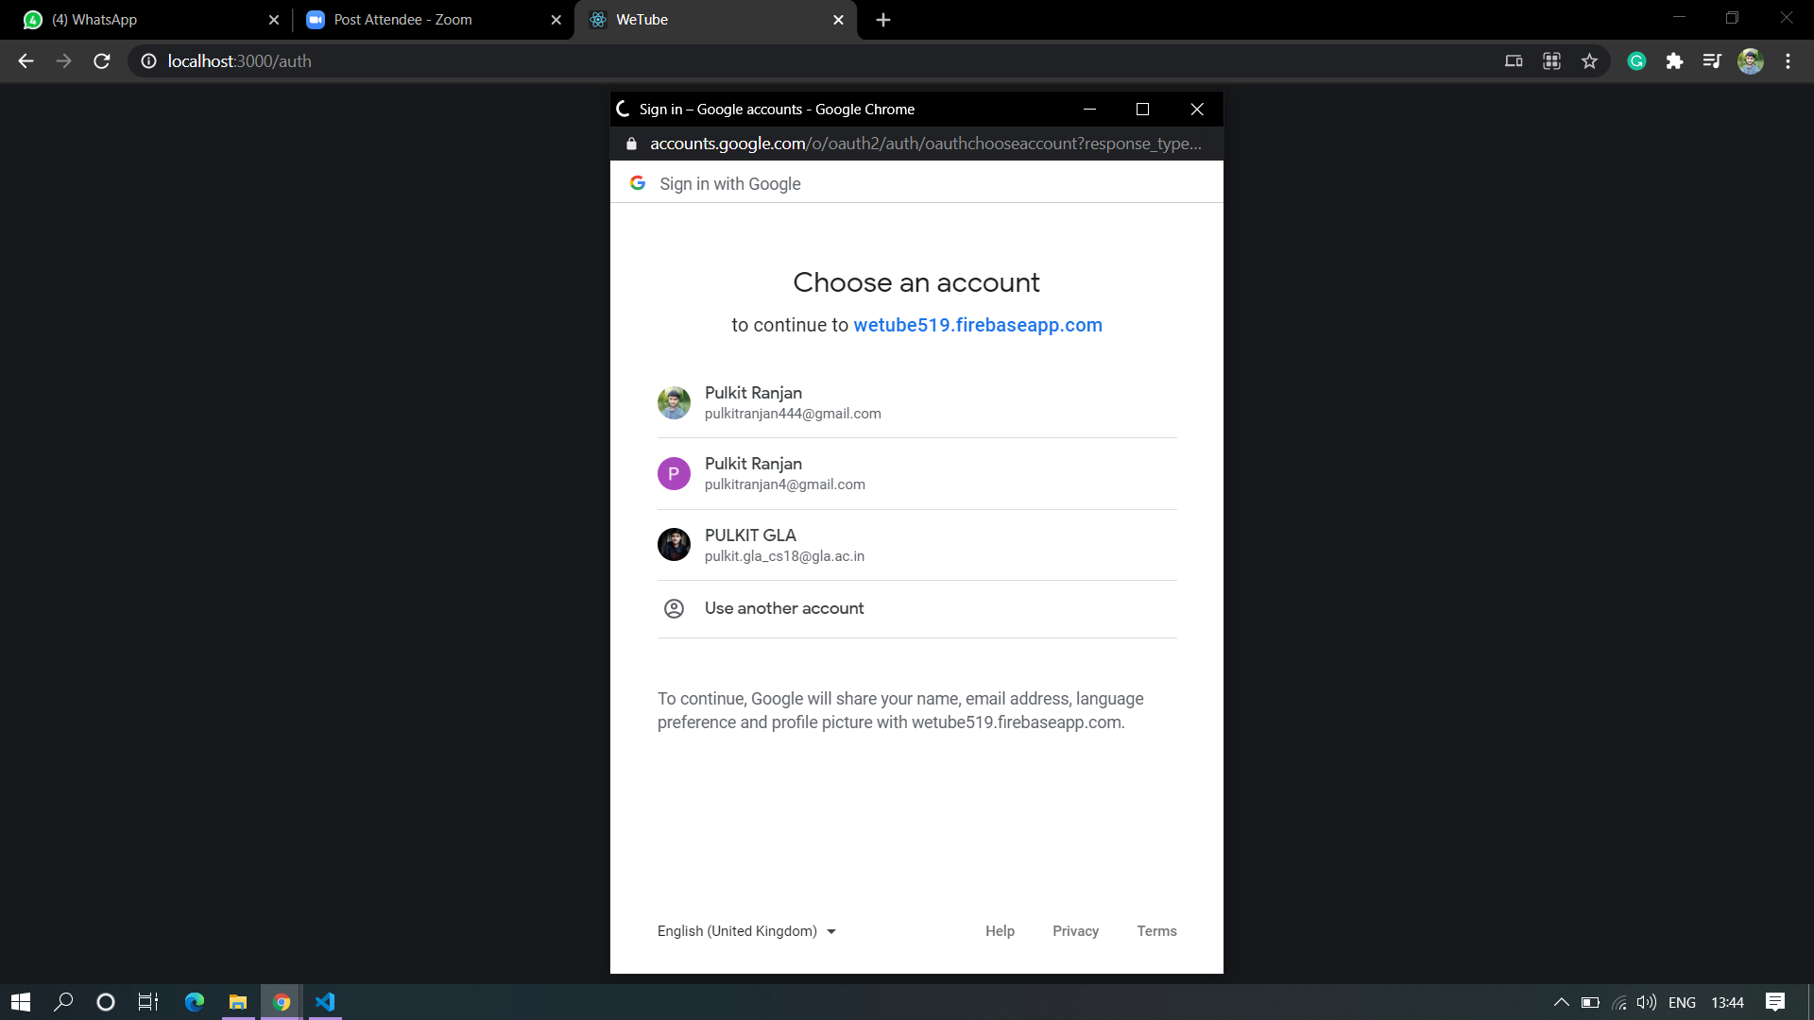

Slide 21
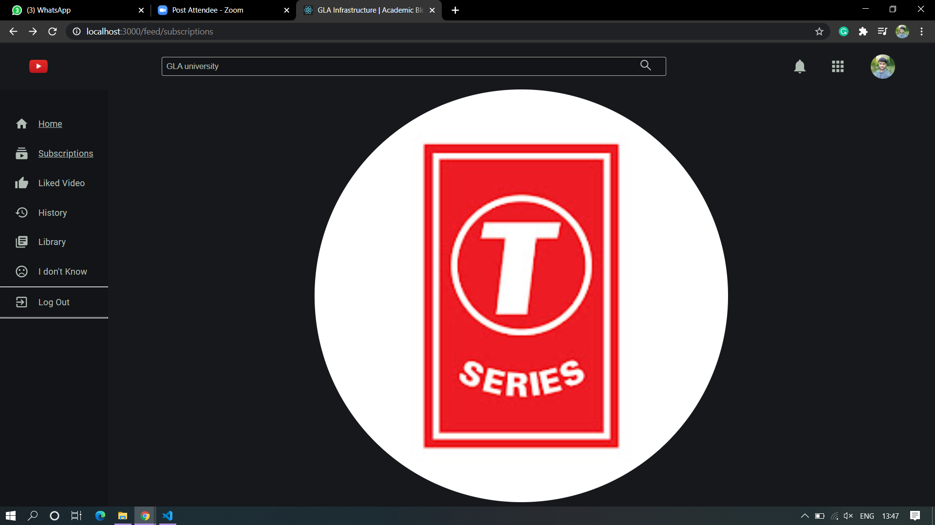

Slide 22
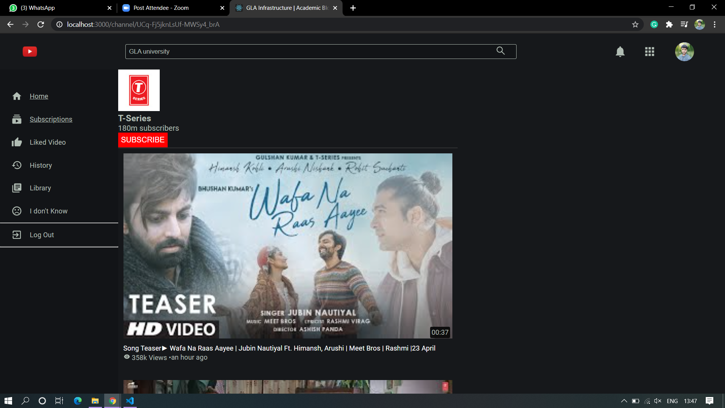

Slide 23
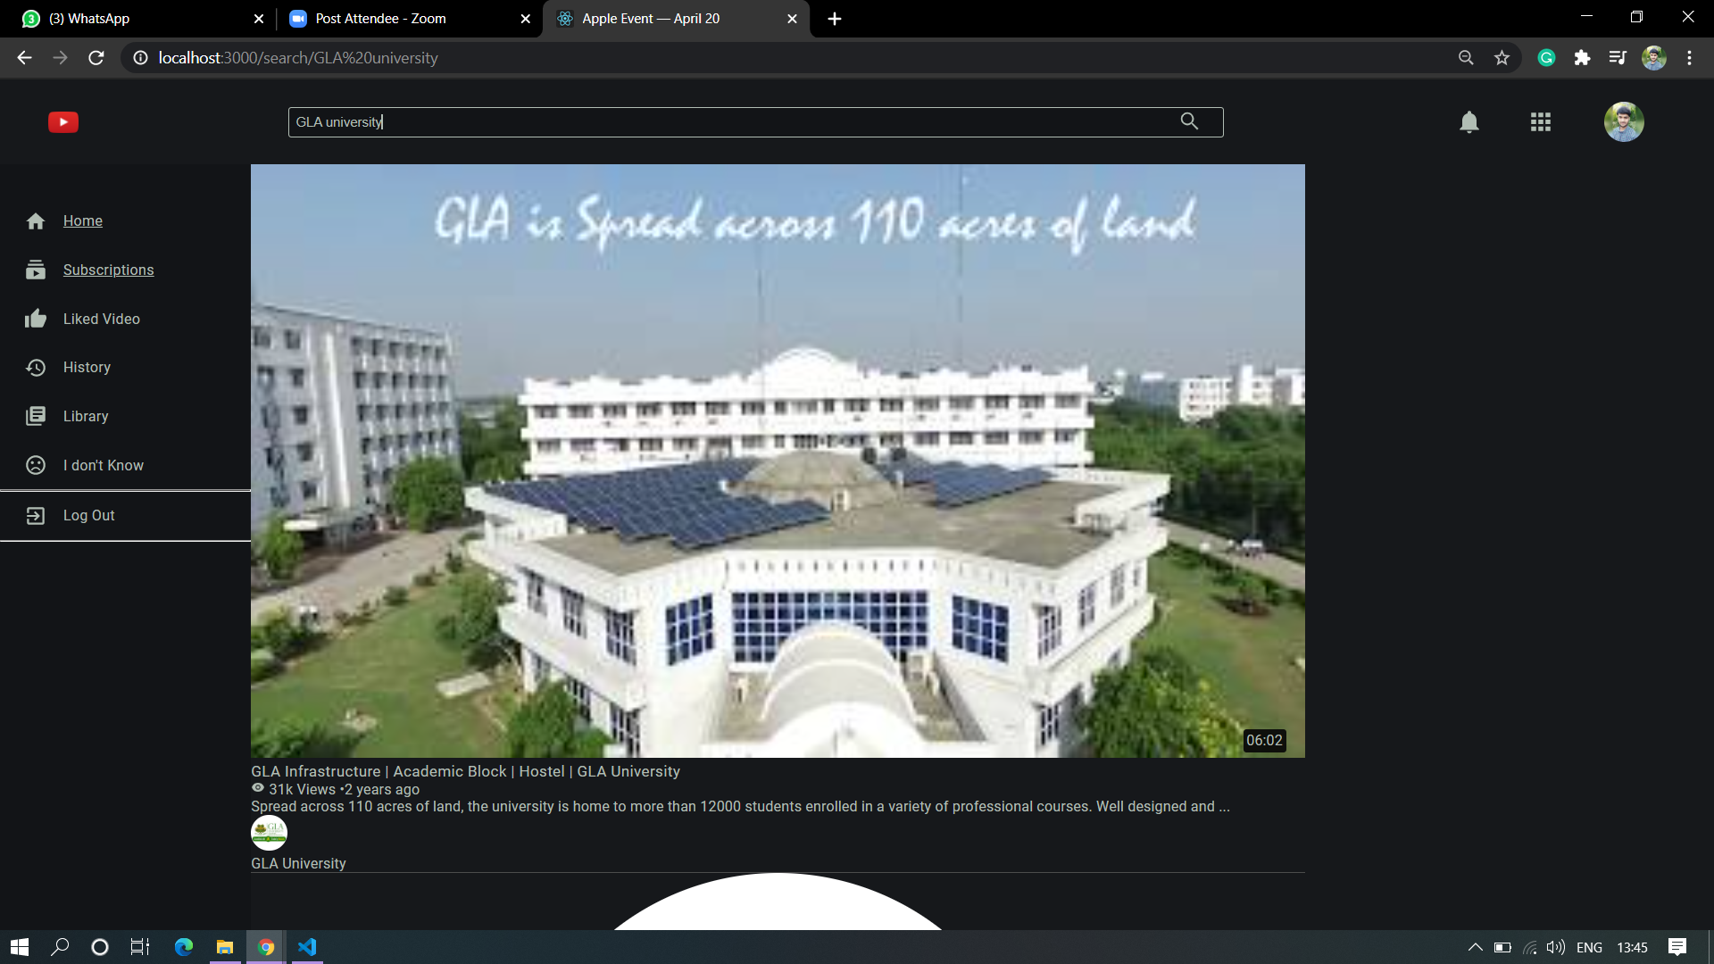

Slide 24
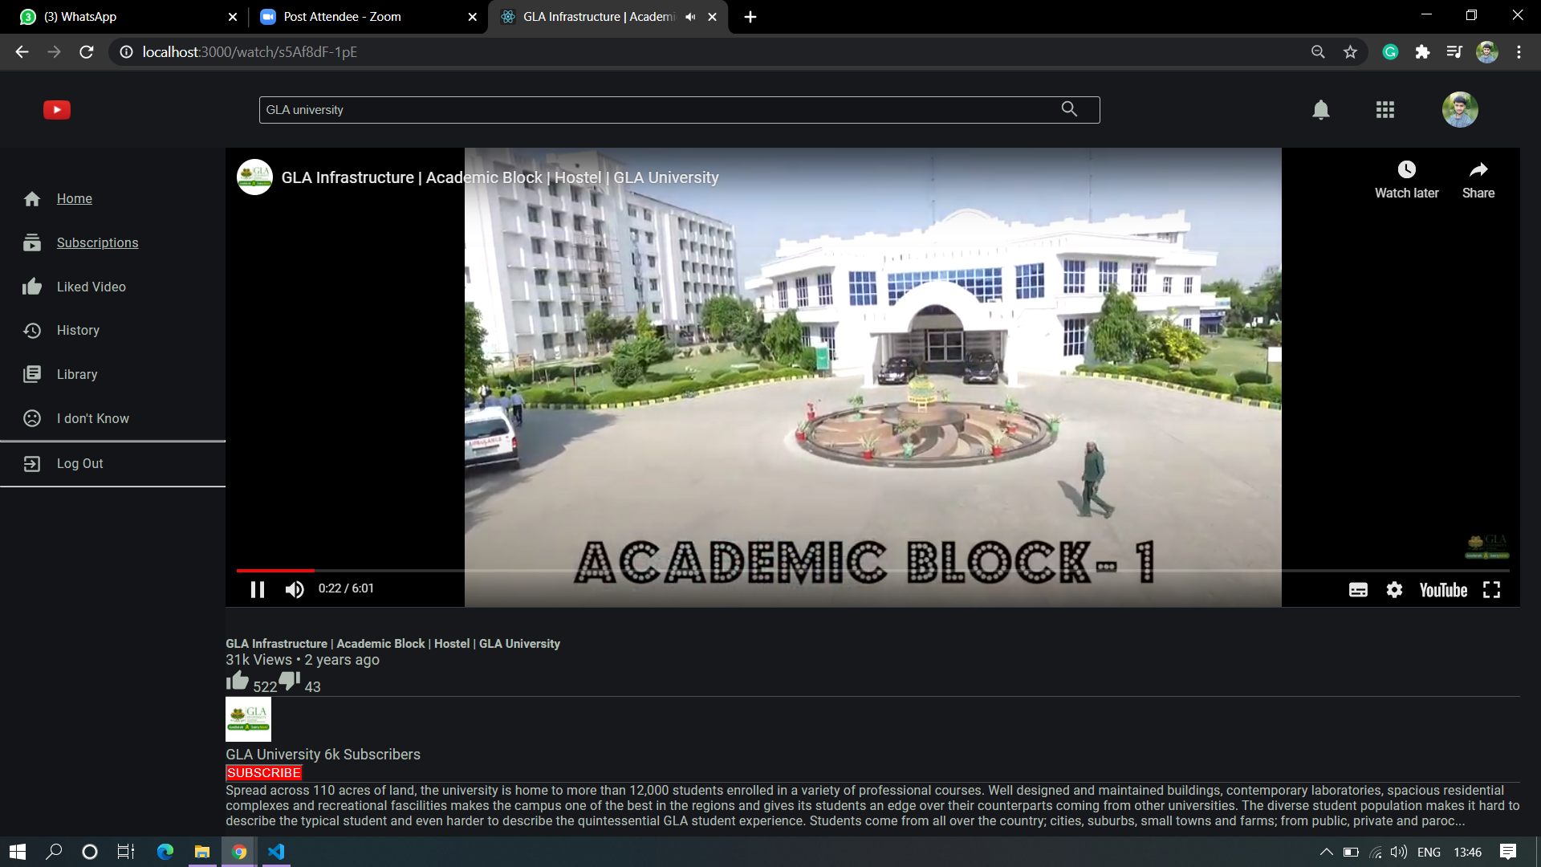

Slide 25
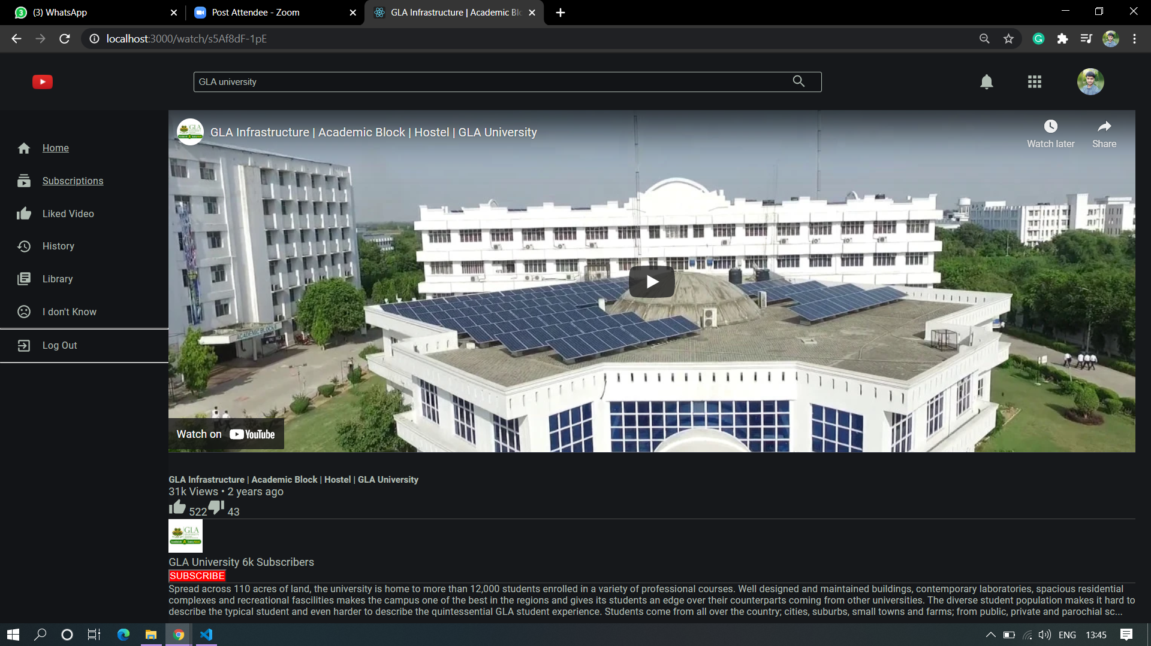

Slide 26
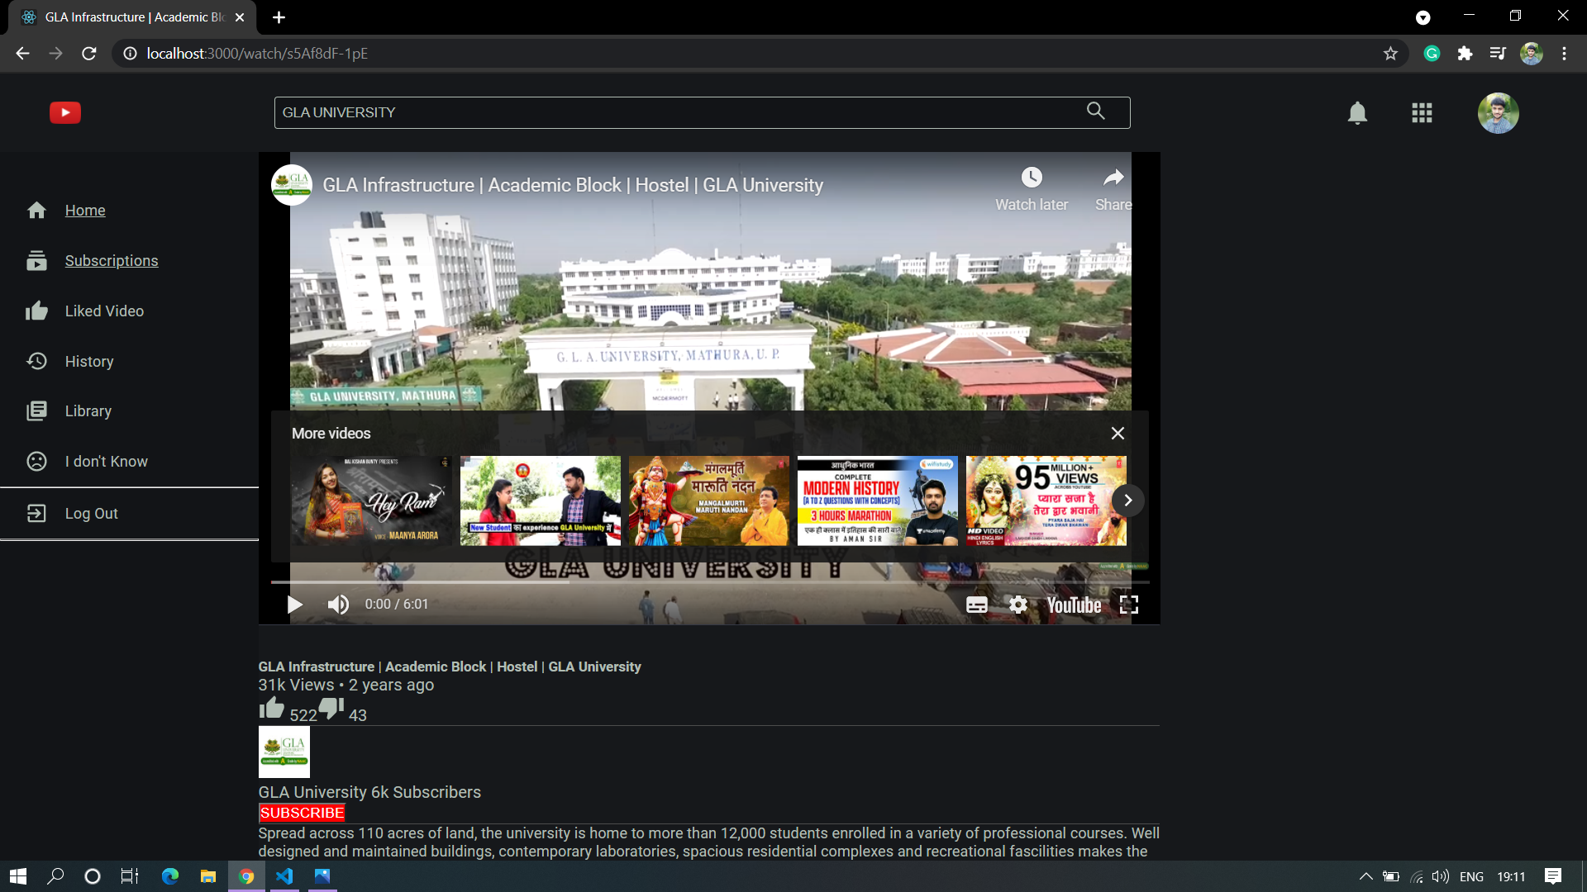

Slide 27
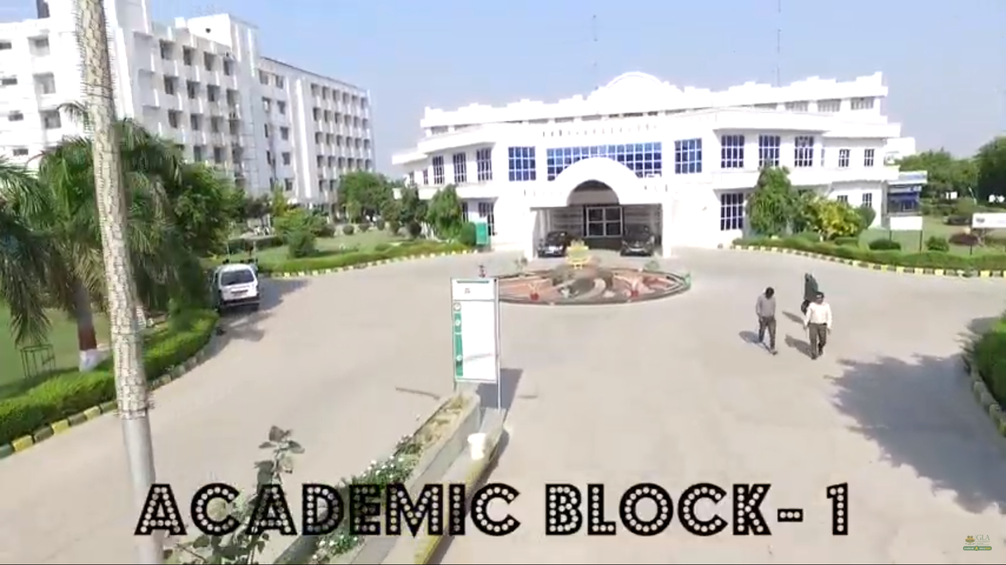

Slide 28
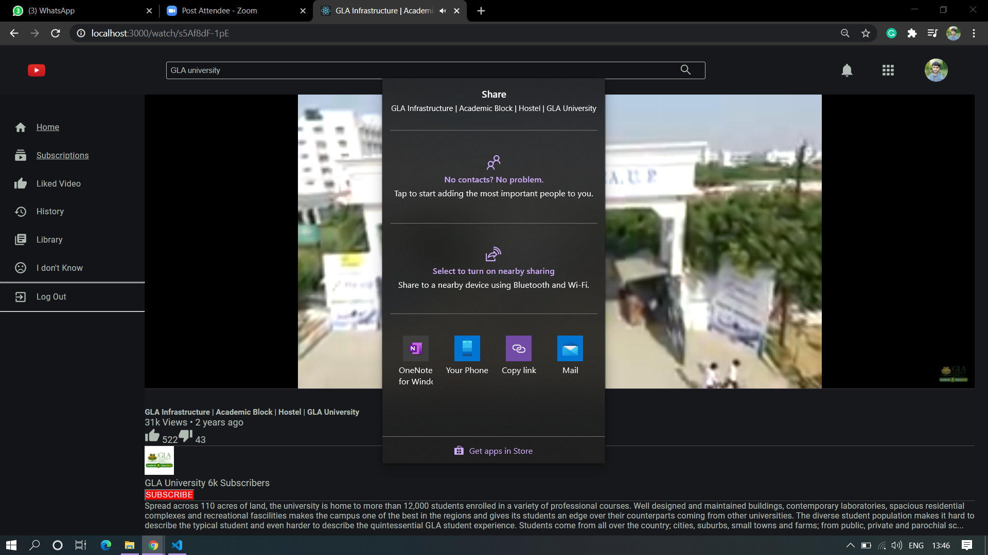

Slide 29
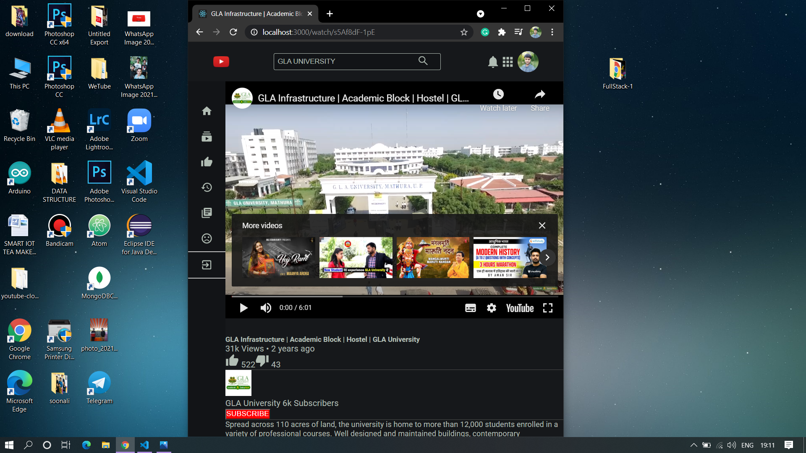

Slide 30
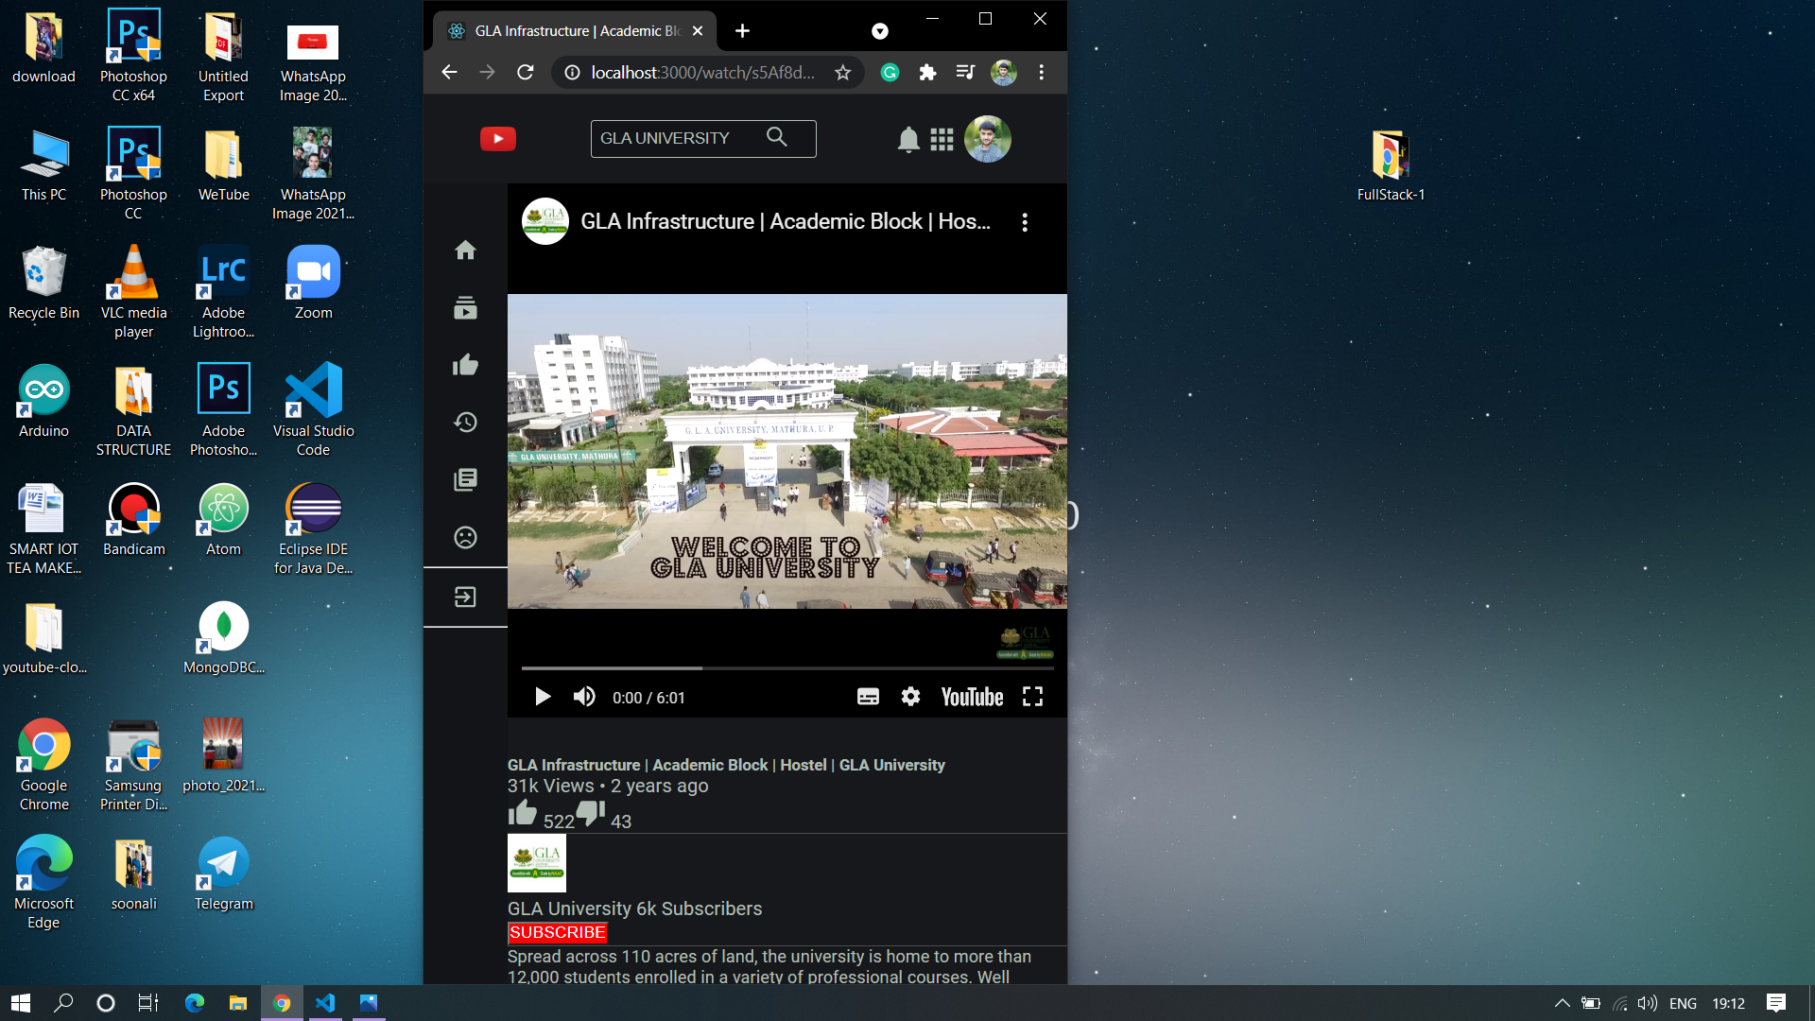

Slide 31
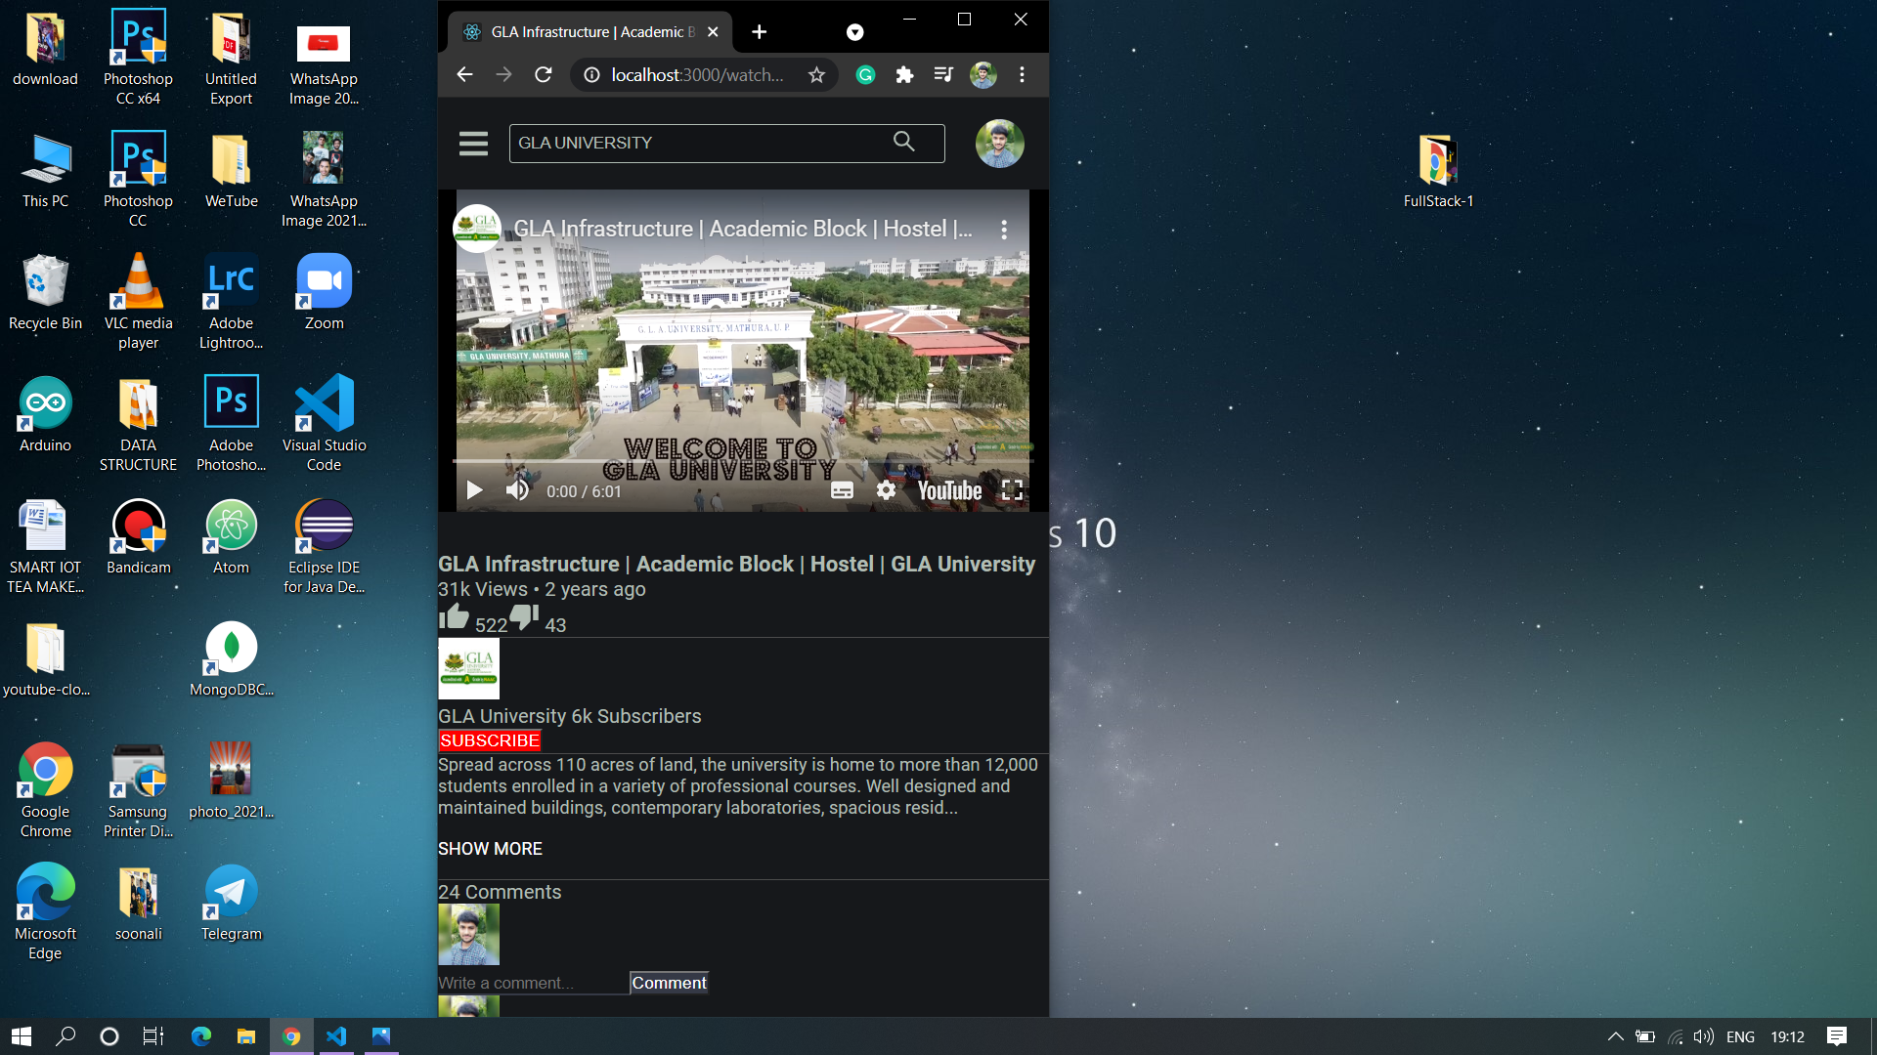

Slide 32
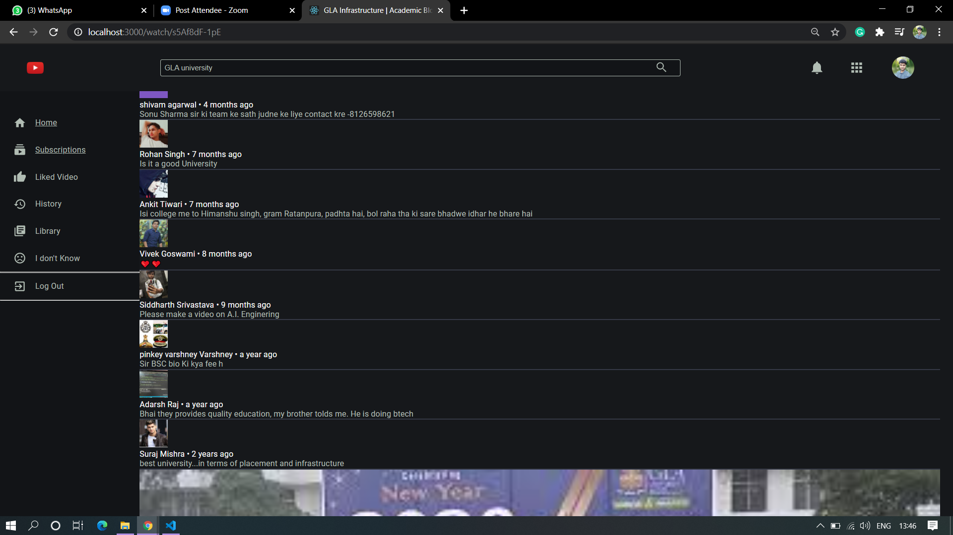

Slide 33
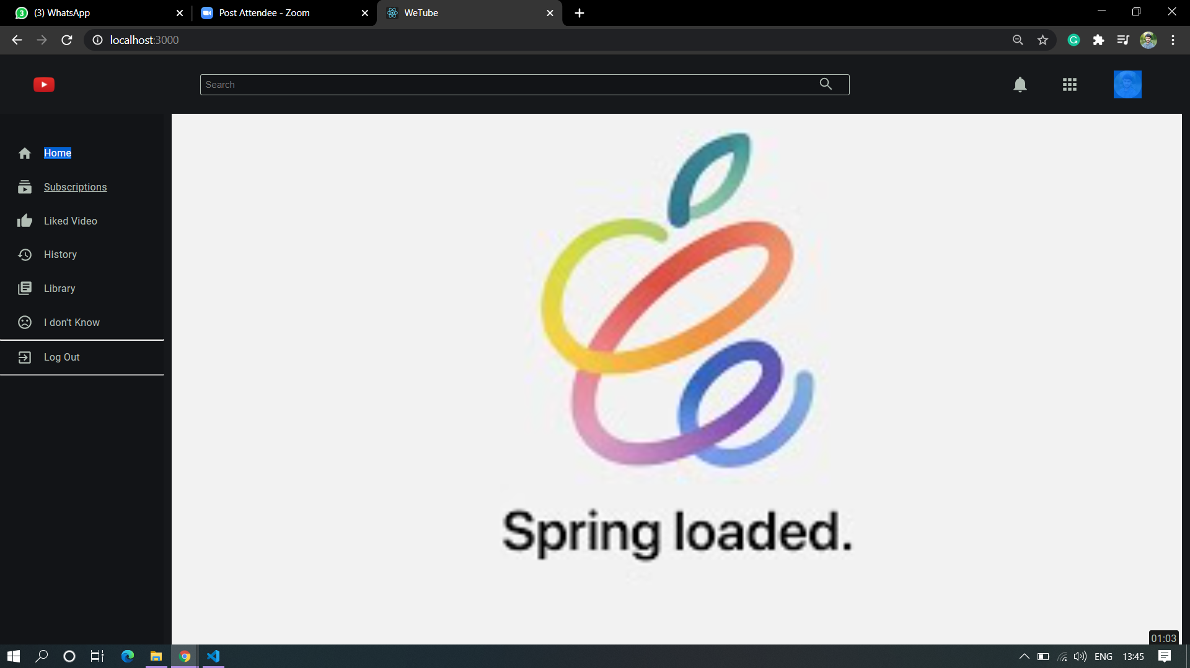

Slide 34
Limitations
The only limitation of this project is that it is not yet deployed globally on internet. It runs on a local server.

Slide 35
Future Scope
Since this project works on a local server, in future we can deploy it globally so different users from any part of the world can stream the video.
We can add own Database in the application which enable user to upload their own videos, and create their own channel.

Slide 36
GitHub Link: https://github.com/Pulkit519/WeTube1
Reference and bibliography
https://nodejs.org/en/
https://reactjs.org/
https://redux.js.org/
https://developers.google.com/youtube/v3
https://www.geeksforgeeks.org/
https://youtu.be/JnvKXcSI7yk
https://www.youtube.com/watch?v=poQXNp9ItL4
https://www.youtube.com/watch?v=RGKi6LSPDLU

Slide 37
Thank You

